Slide 1
Basic Concept of Macroeconomics
Chathuranga Adhikari
B.com (Sp)(Hons), M.com

Slide 2
Learning Outcomes
To understand the meaning of Macroeconomics
To understand the scope of Macroeconomics
To understand the importance of Macroeconomics

Slide 3
Definition of Macroeconomics
Macroeconomics deals with the total or aggregate level of output, the aggregate level of consumption, the aggregate level of investment, the aggregate level of employment, and the general price level in the economy.
Macroeconomics is the study of the behavior of the economy as a whole. It examines the overall level of a nation’s output, employment, prices, and foreign trade.
Macroeconomics (from the Greek prefix makro- meaning "large" and economics) is a branch of economics dealing with the performance, structure, behavior, and decision-making of an economy as a whole, rather than individual markets. This includes national, regional, and global economies

Slide 4
Macroeconomic Concerns
Three of the major concerns of macroeconomics are:
Unemployment
Inflation
Output growth

Slide 5
1. Unemployment
Unemployment refers to the situation where the population of a country does not find work to earn their livelihood.
Unemployment represents the ratio of the labor force which fails to get employment.
The unemployment rate is a key indicator of the economy’s health.
The existence of unemployment seems to imply that the aggregate labor market is not in equilibrium.

Slide 6
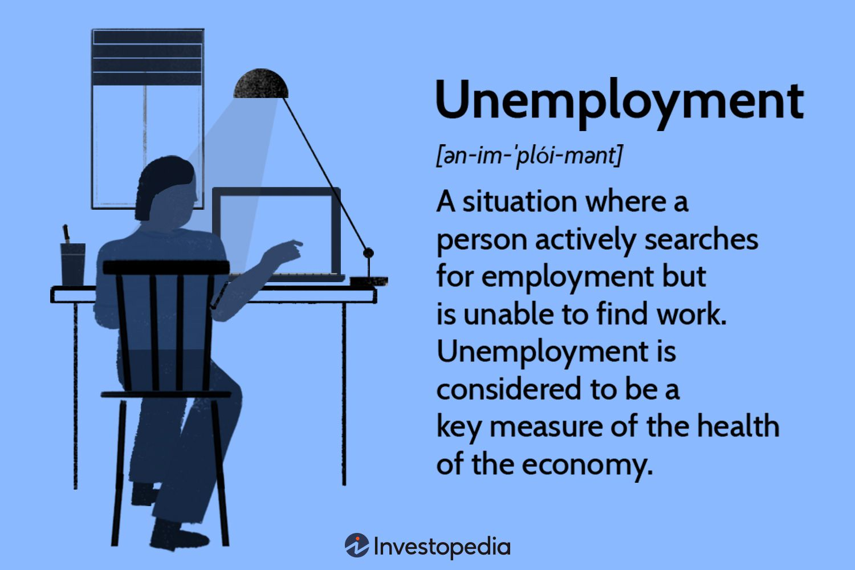
Unemployment

Slide 7
Why Unemployment is a Problem
Unemployment results in
  Lost incomes and production
  Lost human capital
The loss of income, and employment benefits create a safety net but don’t fully replace lost wages, and not everyone receives benefits.
Prolonged unemployment permanently damages a person’s job prospects by destroying human capital.

Slide 8
Employment and Unemployment
The working-age population is divided into two groups:
People in the labor force
People not in the labor force
The labor force is the sum of employed and unemployed workers.

Slide 9
Effects of Unemployment
On an individual level unemployment reduces the level of income that an individual earns
As their income has been reduced consumption also reduces as they pay for necessities rather than luxuries
Goods that are income elastic will be consumed less
Quality of life will be reduced for the unemployed worker

Slide 10
Economic effects of unemployment
If unemployment rates are rising their will be a negative impact on economic growth potential
Consumption is likely to fall as consumers will have had a decrease in income levels
Government spending will increase as the government will be responsible for benefit payments
Taxation levels will decrease as less people are in work and therefore paying taxes

Slide 11
Influence of Unemployment
Impact on The Economy
Reduce national output
When there is a large number of unemployed labor, then production from some sectors of the economy will decline and consequences for the country's national output will be reduced.

Slide 12
Influence of Unemployment
Lower standard of living.
The standard of living of a country is measured using per capita income. When there are many labor unemployed, the gross national product will be reduced and this will reduce the per capita income. When income per capita is falling, then the standard of living will fall.
Increase the incidence of poverty.

Slide 13
Influence of Unemployment
Reduce national income.
When unemployment is high, then the income or profits of the firm will decrease. This will reduce the amount of income tax and company profit that can be collected by the government and thus will reduce national income.
Slow down the process of national development.

Slide 14
Influence of Unemployment
Impact on the Social
Create unsafe conditions in the family.
Increased incidence of crime in the community.
Cause stress and lack of confidence

Slide 15
Effects of Unemployment
Unemployment can have significant effects on the performance of the economy as a whole
The effects are most marked due to long terms unemployment
If there is unemployment in the economic resources are not being used effectively and the economy will be operating below any points on the PPF curve

Slide 16
Full Employment
Full employment is defined as a situation in which the unemployment rate equals the natural unemployment rate.
When the economy is at full employment, there is no cyclical unemployment or, equivalently, all unemployment is frictional and structural.

Slide 17
2. Inflation
Inflation- The rise in the general level of prices
In the long term, inflation erodes consumer purchasing power.
That means that accumulated wealth buys less and less, with the passage of time.
Where there is high inflation it is difficult for businesses to plan for the future as there is uncertainty regarding the cost of raw materials

Slide 18
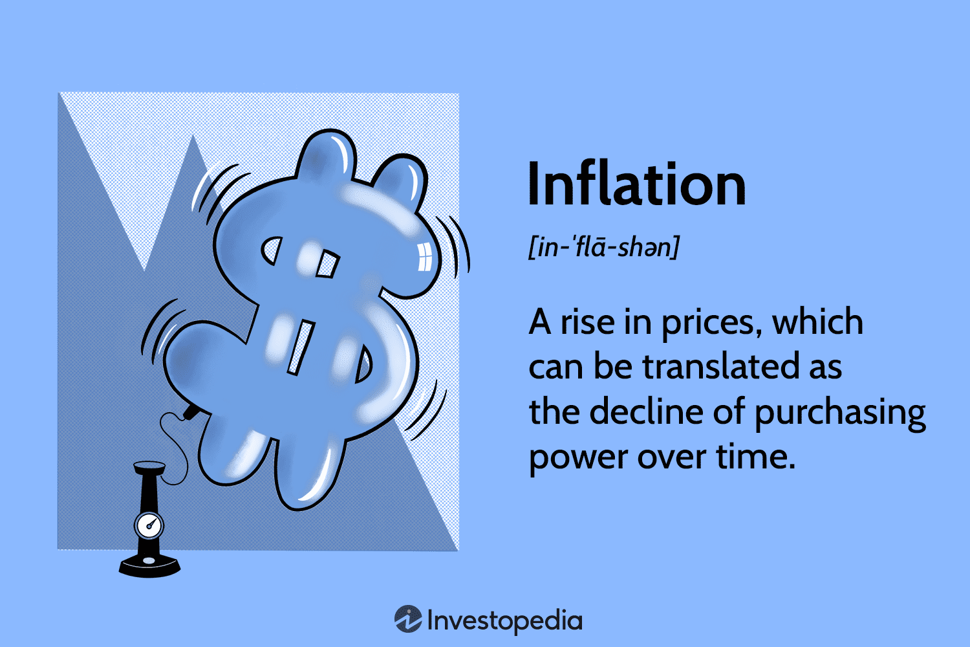
Inflation

Slide 19
Types
Inflation is an increase in the overall price level.
Hyperinflation is a period of very rapid increases in the overall price level. Hyperinflation is a rare phenomenon.
Deflation is a decrease in the overall price level. Prolonged periods of deflation can be just as damaging for the economy as sustained inflation

Slide 20
The causes of inflation
Inflation results when the macro economy has too much demand for available production. These alternatives fall under two general categories:
Demand-Pull Inflation: This inflation occurs when households, businesses, governments, and foreign industries collectively try to purchase more output than the economy is capable of producing. In effect, the demand side of the aggregate market is "pulling" the price level higher.
Cost-Push Inflation: Cost-push inflation is inflation attributable to decreases in supply, primarily due to increases in production cost

Slide 21
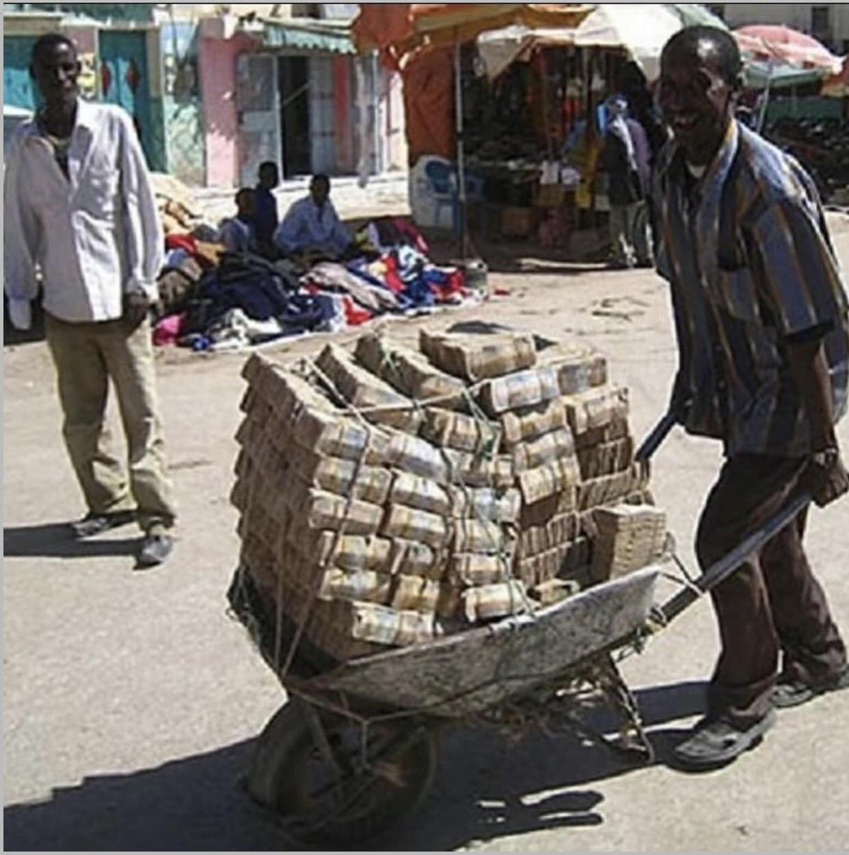
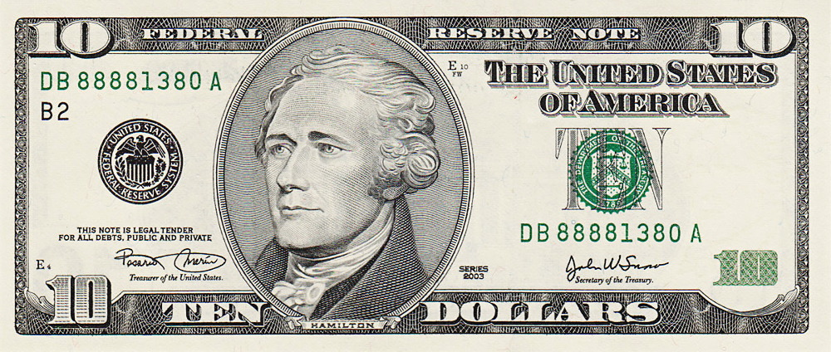

Slide 22
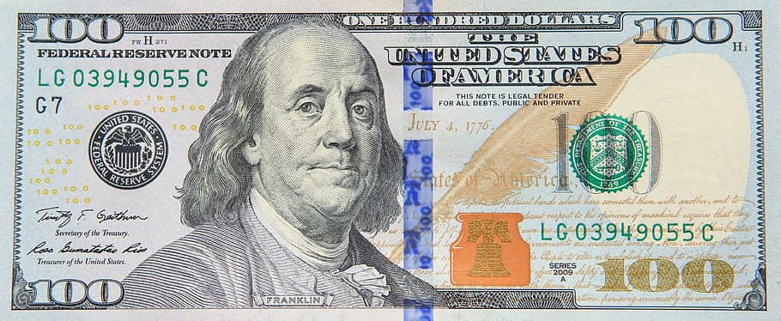
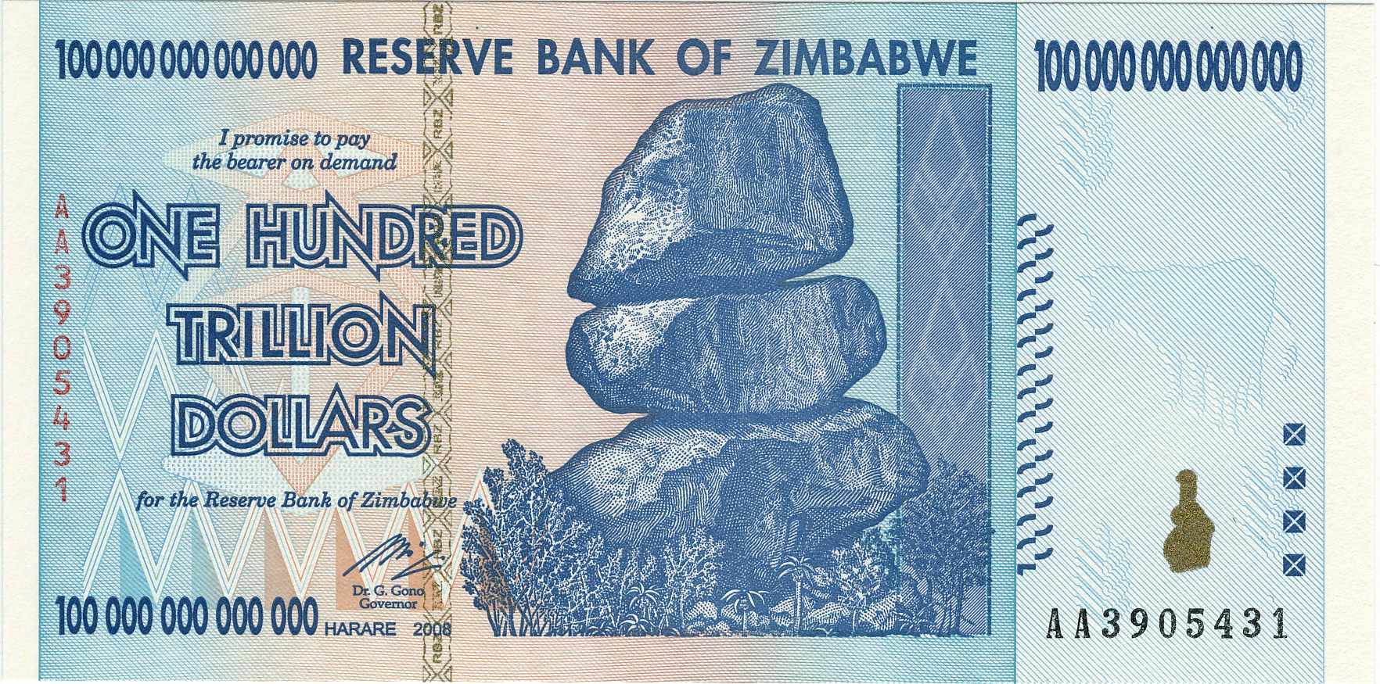
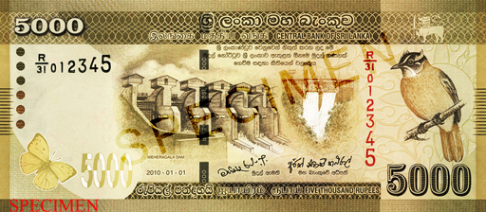

Slide 23
Causes of Deflation
Deflation involves a fall in the price level – a negative rate of inflation. From a very basic standpoint, there are two main potential causes of deflation:
A fall in aggregate demand (AD)
A shift to the right of aggregate supply (AS)
i.e., lower costs of production through improved technology.

Slide 24
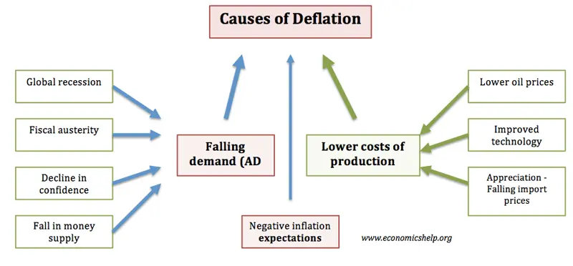
Causes of Deflation

Slide 25
Why Inflation and Deflation Are Problems?
Affect the distribution of income and wealth
Wage contracts between workers and employers has resulted in losses to the employee if inflation is not expected to be too high, while wages will not rise immediately.
Lowers real GDP and employment

Slide 26
Causes of hyperinflation
A high Money supply leads to higher demand leaving the supply as constant. Hence, prices of goods and services tend to rise.
Demand-pull inflation is where there is a sudden increase in demand with constant supply.
The market loses confidence where citizens start losing confidence in the currency.
The warlike situation between different countries can also cause hyperinflation.

Slide 27
Effects of hyperinflation
Currency value depreciates
Investment in gold, real estate, and commodities increases
Foreign investors back out
Shortage of basic food supplies
Disrupts the banking and financial institutions
Exports are cheaper, imports are costlier
Unemployment increases and the government’s revenue fall

Slide 28
Creeping Inflation
“When the rise in prices is very low like that of a snail or creeper, is called Creeping Inflation”
Here the inflation rate is 5%.
The general level of prices rises at a moderate rate over a long period of time.

Slide 29
3. Output and Growth
Growth refers to a change in the level of economic activity from one year to another year.
Growth means that poor and developing countries wish to attain a rise in their national income and per capita income.
Aggregate output is the total quantity of goods and services produced in an economy in a given period.
The aggregate output is the main measure to see how well an economy is doing

Slide 30
Growth
It is of great concern to economists what should be the level of rise in investment so that the economy can achieve its desired level of income and employment without inflation and deflation. Such a situation will result in the full utilization of resources.
Full employment means the maximization of output & employment in presence of existing recourses while growth is attached to an increase in output & employment.

Slide 31
Nature and Scope of Macroeconomics
Macroeconomics is the study of aggregates or averages covering the entire economy, such as total employment, national income, national output, total investment, total consumption, total savings, aggregate supply, aggregate demand, and general price level, wage level, and cost structure.
Macroeconomics is also known as the theory of income and employment, or simply income analysis. It is concerned with the problems of unemployment, economic fluctuations, inflation or deflation, international trade, and economic growth. It is the study of the causes of unemployment, and the various determinants of

Slide 32
The Goals of Macroeconomic Policy
Full employment
Price stability
Rapid economic growth
Reduction of economic inequality
Stable exchange rate
Protect environment
High living standards

Slide 33
Key Macro Economic Variables
National Income and GDP
Unemployment
Economic growth
Inflation
International Trade
Balance of Payment
Monetary & Fiscal Policy
Interest Rate
Stock Market
Business Cycle
Exchange Rate

Slide 34
1. Gross Domestic Product
GDP refers to the monetary value of all the finished goods and services produced within a country's borders in a specific time period, though GDP is usually calculated on an annual basis.
It includes all private and public consumption, government outlays, investments, and exports fewer imports that occur within a defined territory.
The gross domestic product (GDP) is one of the primary indicators used to gauge the health of a country's economy.

Slide 35
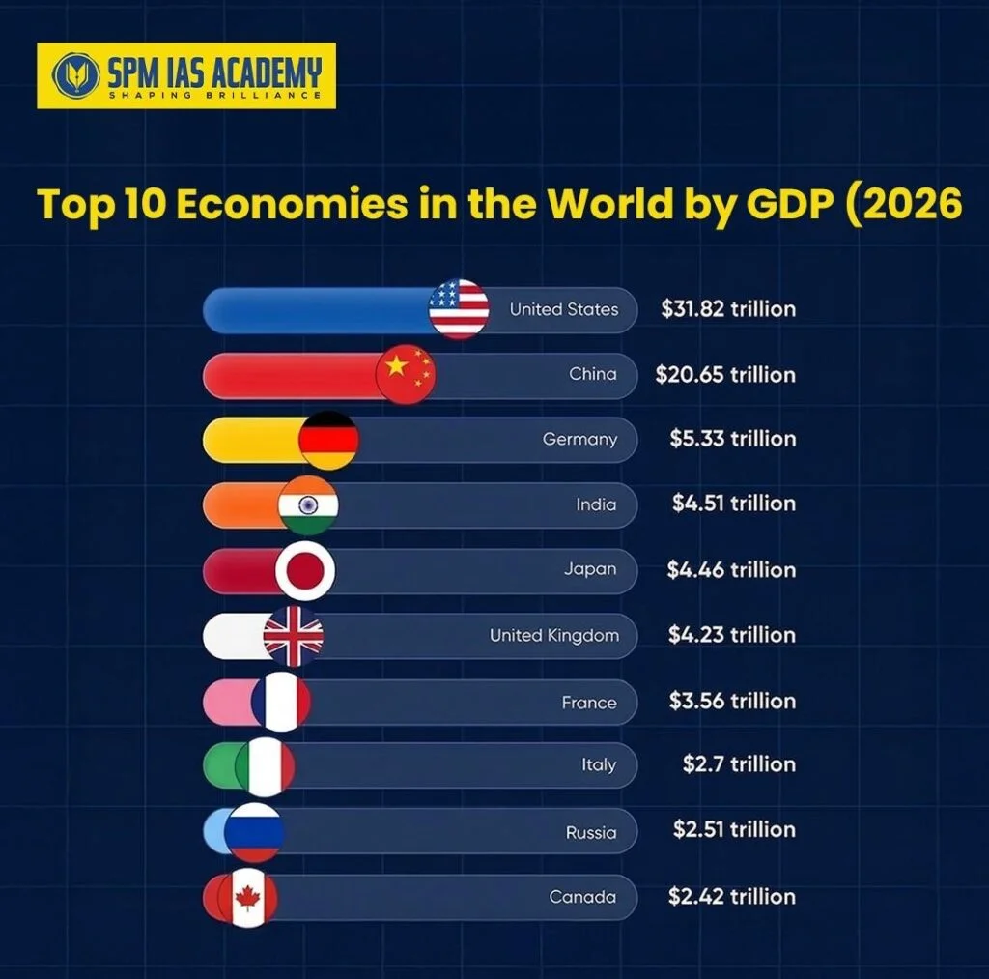
GDP

Slide 36
2. National Income
National Income is the total value of all goods and services produced within a nation over a specified period of time, representing the sum of wages, profits, rents, interest, and pension payments to residents of the nation.
It gives a correct picture of the economy and purchasing power of people in the country.

Slide 37
3. Unemployment
The Unemployment Rate:
to be unemployed, a person must want to work and be actively looking for a job (but have not yet found one)
the labor force consists of those who are employed and those who are unemployed
the unemployment rate is equal to the number of unemployed people divided by the labor force

Slide 38
4. Economic growth
Economic growth is the increase in the market value of the goods and services produced by an economy over time.
Also, economic growth is the increase in the capacity of an economy to produce goods and services, compared from one period of time to another.

Slide 39
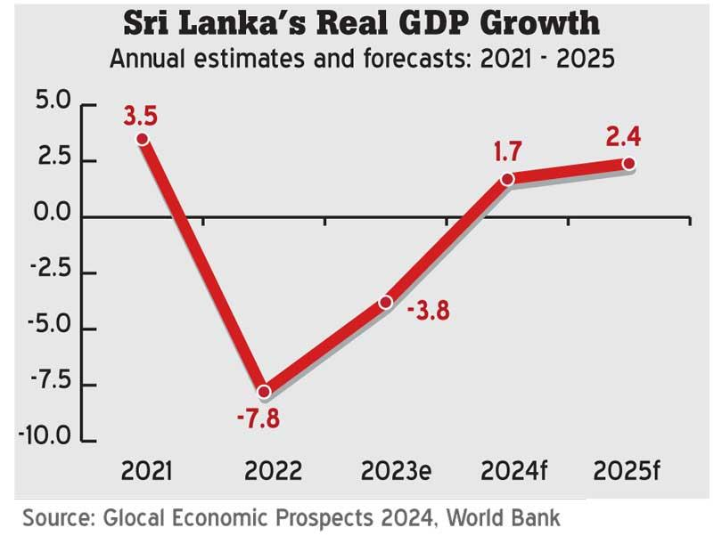
Economic Growth

Slide 40
5. Inflation
In economics, inflation means, a rise in the general level of prices of goods and services in an economy over a period of time. When the general price level rises, each unit of currency buys fewer goods and services. Thus, inflation results in a loss of the value of money. Another popular way of looking at inflation is "too much money chasing too few goods".
Inflation is caused when goods and services are in high demand, creating a drop in availability. Consumers are willing to pay more for the items they want, causing manufacturers and service providers to charge more. Supplies can decrease for many reasons: A natural disaster can wipe out a food crop or a housing boom can exhaust building supplies, among other situations.

Slide 41
6. International trade
International trade is the exchange of goods and services between countries. This type of trade gives rise to a world economy, in which prices, or supply and demand, affect and are affected by global events.
International trade allows for expansion markets for both goods and services that otherwise may not have been available to all. It is the reason why you can pick between a Japanese, German, or American car.
As a result of international trade, the market contains greater competition and therefore more competitive prices, which brings a cheaper product home to the consumer.

Slide 42
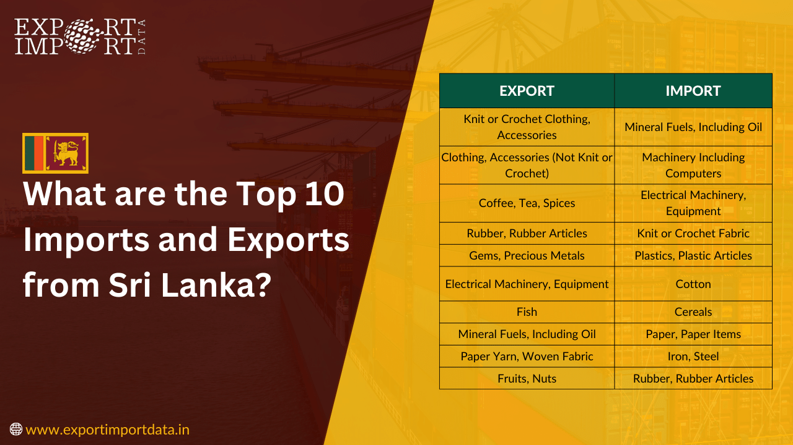
Sri Lanka’s Imports & Exports

Slide 43
7. Balance of payment (BOP)
The balance of payments (BOP) of a country is the record of all economic transactions between the residents of a country and the rest of the world in a particular period (over a quarter of a year or more commonly over a year).
These transactions are made by individuals, firms, and government bodies. Thus the balance of payments includes all external visible and non-visible transactions of a country during a given period, usually a year.
It represents a summation of the country's current demand and supply of the claims on foreign currencies and of foreign claims on its currency.

Slide 44
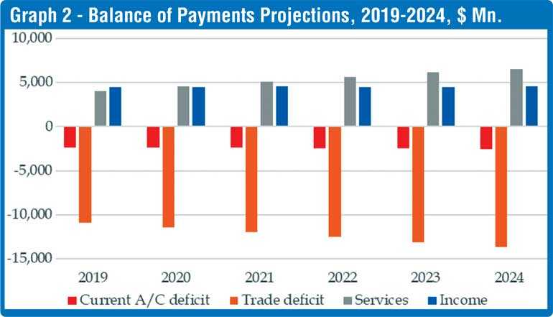
BOP

Slide 45
8. Monetary Policy
Monetary policy is the process by which the monetary authority of a currency controls the supply of money, often targeting an inflation rate or interest rate to ensure price stability and general trust in the currency.
Further goals of a monetary policy are usually to contribute to economic growth and stability, to low unemployment, and rates with other currencies, and too predictable exchange

Slide 46
9. Fiscal Policy
Fiscal policy is the means by which a government adjusts its spending levels and tax rates to monitor and influence a nation's economy.
It is the sister strategy to monetary policy through which a central bank influences a nation's money supply. These two policies are used in various combinations to direct a country's economic goals.

Slide 47
10. Interest rate
An interest rate is a rate at which interest is paid by borrowers (debtors) for the use of money that they borrow from lenders (creditors). Specifically, the interest rate is a percentage of principal paid a certain number of times per period for all periods during the total term of the loan or credit.
Many different interest rates in the economy vary by duration and degree of risk.

Slide 48
11. Stock Market
A stock market or equity market is the aggregation of buyers and sellers (a loose network of economic transactions, not a physical facility or discrete entity) of stocks (also called shares); these may include securities listed on a stock exchange as well as those only traded privately.
History has shown that the price of stocks and other assets is an important part of the dynamics of economic activity, and can influence or be an indicator of social mood.
An economy where the stock market is on the rise is considered to be an up-and-coming economy. In fact, the stock market is often considered the primary indicator of a country's economic strength and development.

Slide 49
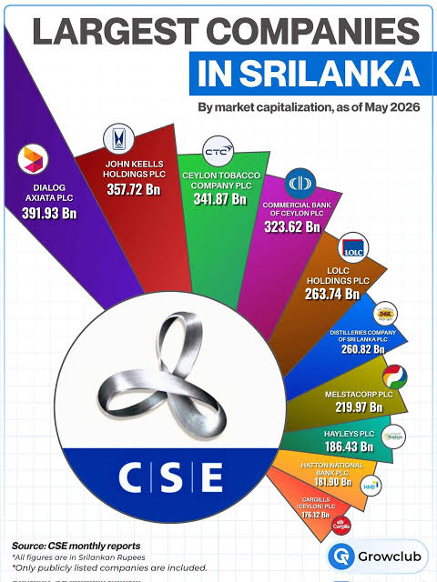
Market Cap

Slide 50
12. Business cycle
The term business cycle (or economic cycle or boom–bust cycle) refers to fluctuations in aggregate production, trade, and activity over several months or years in a market economy.
The business cycle is the downward and upward movement of levels of gross domestic product (GDP) and refers to the period of expansions and contractions in the level of economic activities (business fluctuations) around its long-term growth trend.
These fluctuations occur around a long-term growth trend and typically involve shifts over time between periods of relatively rapid economic growth (an expansion or boom), and periods of relative stagnation or decline (a contraction or recession).

Slide 51
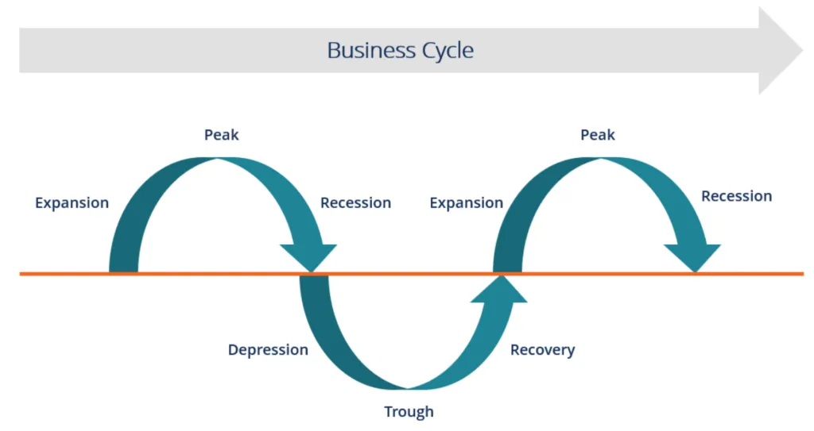
Business Cycle

Slide 52
13. Exchange Rate
The Exchange Rate between two currencies is the rate at which one currency will be exchanged for another.
It is also regarded as the value of one country’s currency in terms of another currency.
  governs the terms on which international trade and investment take place
  nominal exchange rate is the rate at which monies of different countries can be exchanged for one another
  real exchange rate is the rate at which the goods and services produced in different countries can be exchanged for one another

Slide 53
Importance of macroeconomics
It helps us understand the functioning of a complicated modern economic system. It describes how the economy as a whole function and how the level of national income and employment is determined on the basis of aggregate demand and aggregate supply.
It helps to achieve the goal of economic growth, a higher GDP level, and a higher level of employment. It analyses the forces which determine the economic growth of a country and explains how to reach the highest state of economic growth and sustain it.
It helps to bring stability to the price level and analyses fluctuations in business activities. It suggests policy measures to control inflation and deflation.
It explains factors that determine the balance of payments. At the same time, it identifies causes of deficit in the balance of payments and suggests remedial measures.

Slide 54
Importance of macroeconomics
It helps to solve economic problems like poverty, unemployment, inflation, deflation, etc., whose solution is possible at the macro level only (in other words, at the level of the whole economy).
With a detailed knowledge of the functioning of an economy at the macro level, it has been possible to formulate correct economic policies and also coordinate international economic policies.
The macroeconomic theory has saved us from the dangers of the application of microeconomic theory to the problems that require us to look at the economy as a whole.

Slide 55
Thank you

